Slide 1

Exploring Mobility Patterns in Metropolitan Melbourne (June 2018-June 2022)
Tao Ma, Henry Leighton, Owen Johannes, Jai Gupta, Tattwamasi Ray

Slide 2


Project Description
The COVID-19 pandemic has had a profound impact on many aspects of life, including transportation and mobility. With the introduction of various restrictions and lockdowns, people have had to adapt their travel behaviors and routines, leading to significant changes in mobility patterns. This study aims to investigate how mobility patterns in Metropolitan Melbourne have evolved from June 2018 to June 2022, with a focus on the impact of the pandemic.

Slide 3

Our Questions
How has each of the different modes of public transport increased or decreased in usage in light of the pandemic? – Henry
Which municipality saw the greatest change in train usage, and which station saw the greatest change in the City of Melbourne? - Tao
Did the pandemic affect the peak hours of train usage in Metropolitan Melbourne? - Jai
How has the volume of pedestrian traffic in Melbourne’s CBD evolved over the time frame? - Owen

Slide 4
Datasets to be used
PTV CSV’s from the discover.data.vic.gov.au website
Pedestrian Counting System API (City of Melbourne’s Open Data API)
Victorian Coronavirus Data

Slide 5
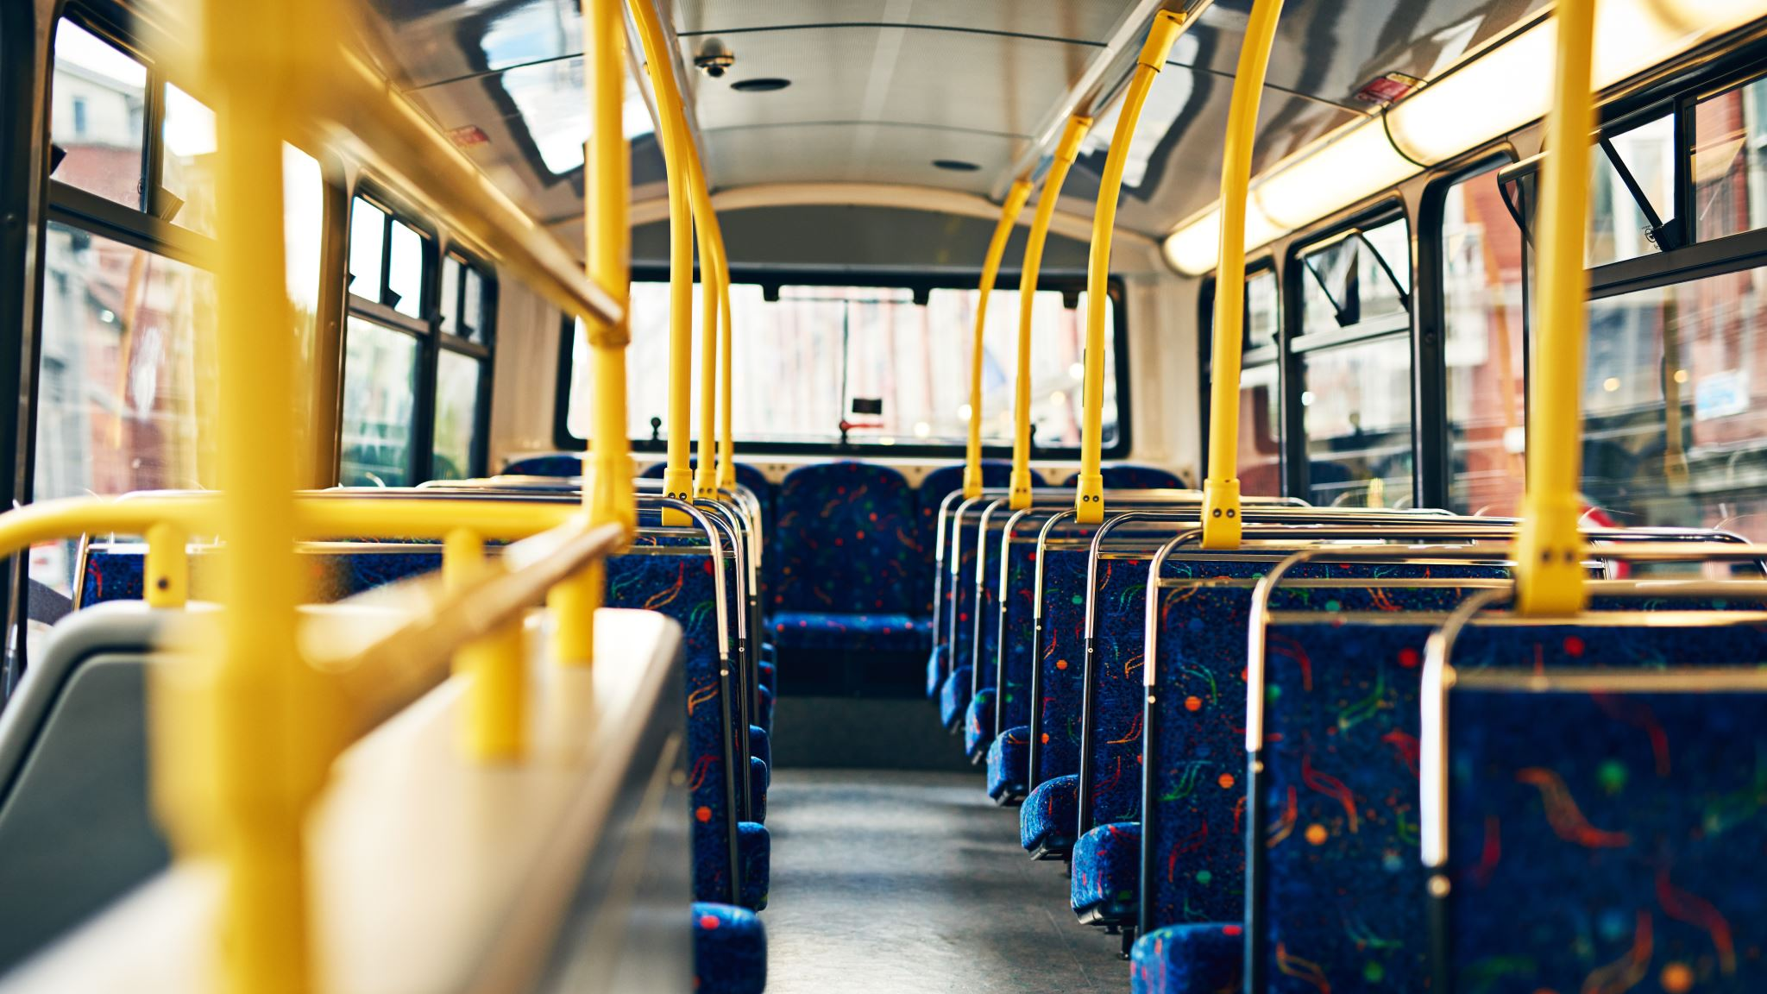
How has each of the different modes of public transport increased or decreased in usage in light of the pandemic?
Presented by Henry Leighton

Slide 6
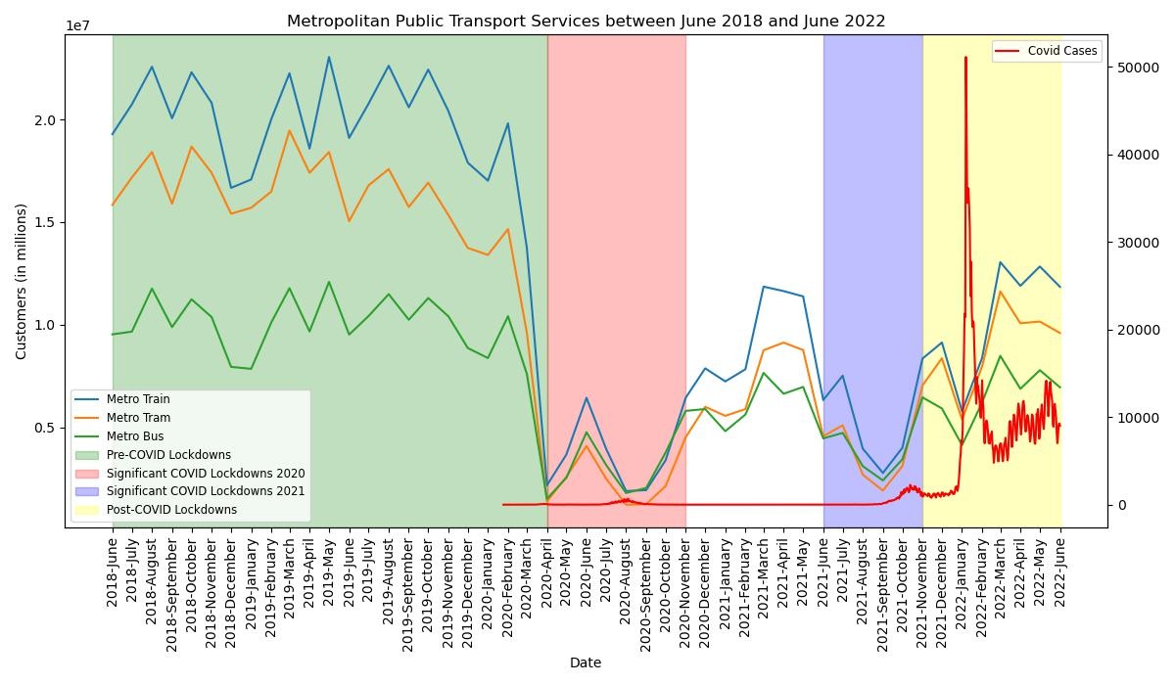

Slide 7
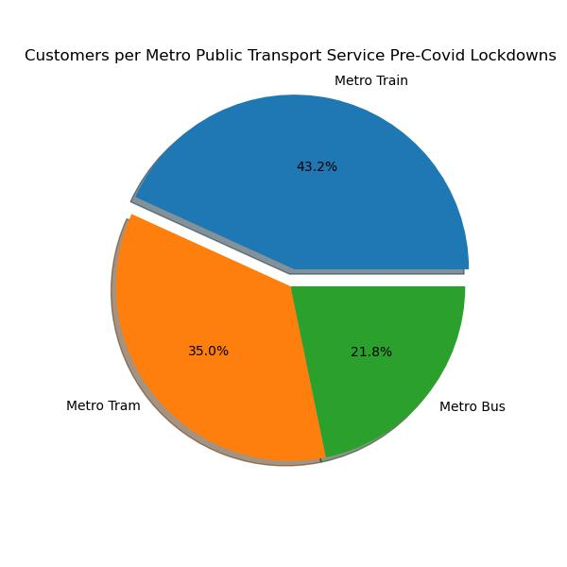
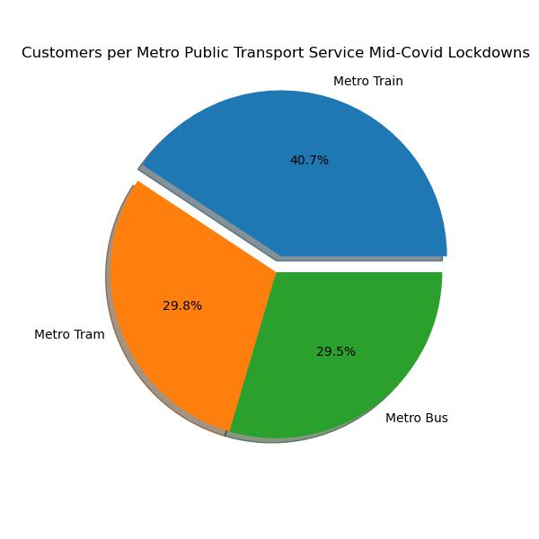
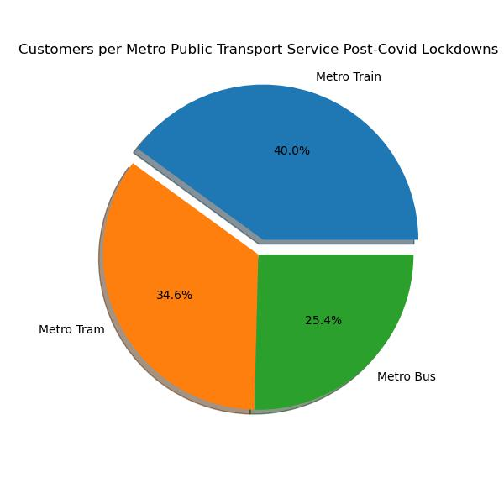

Slide 8
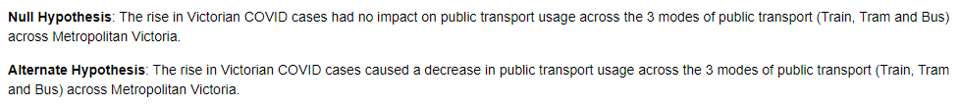
Hypothesis testing

Slide 9
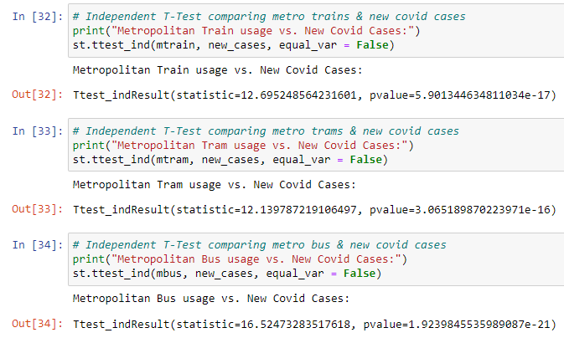
Independent t-tests

Slide 10
Conclusions
We can reject the null hypothesis due to the p-value’s being less than 0.05 for the t-tests.
With the data assessed, we can conclude that there was statistically significant evidence that the rise in Victorian COVID cases had an inverse relationship with public transport usage across the 3 modes of public transport (Train, Tram and Bus) across Metropolitan Victoria.
It also appears that lockdowns enforced over the COVID timeframe lined up with decreases in public transport usage.
Between the 3 methods of public transport assessed, the choice of public transport saw trains (-2.5%) and trams (-5.2%) have a significant decrease during COVID lockdowns with buses being used significantly more (+7.7%), though all had extreme declines in usage numbers.
Post-COVID, trams (+4.8%) have started to take back some of the share of choice of transport that went to buses (-4.1%), whilst trains (-0.7%) have stabilised but are still decreasing in choice of transport over the period of time since COVID lockdowns ended.

Slide 11
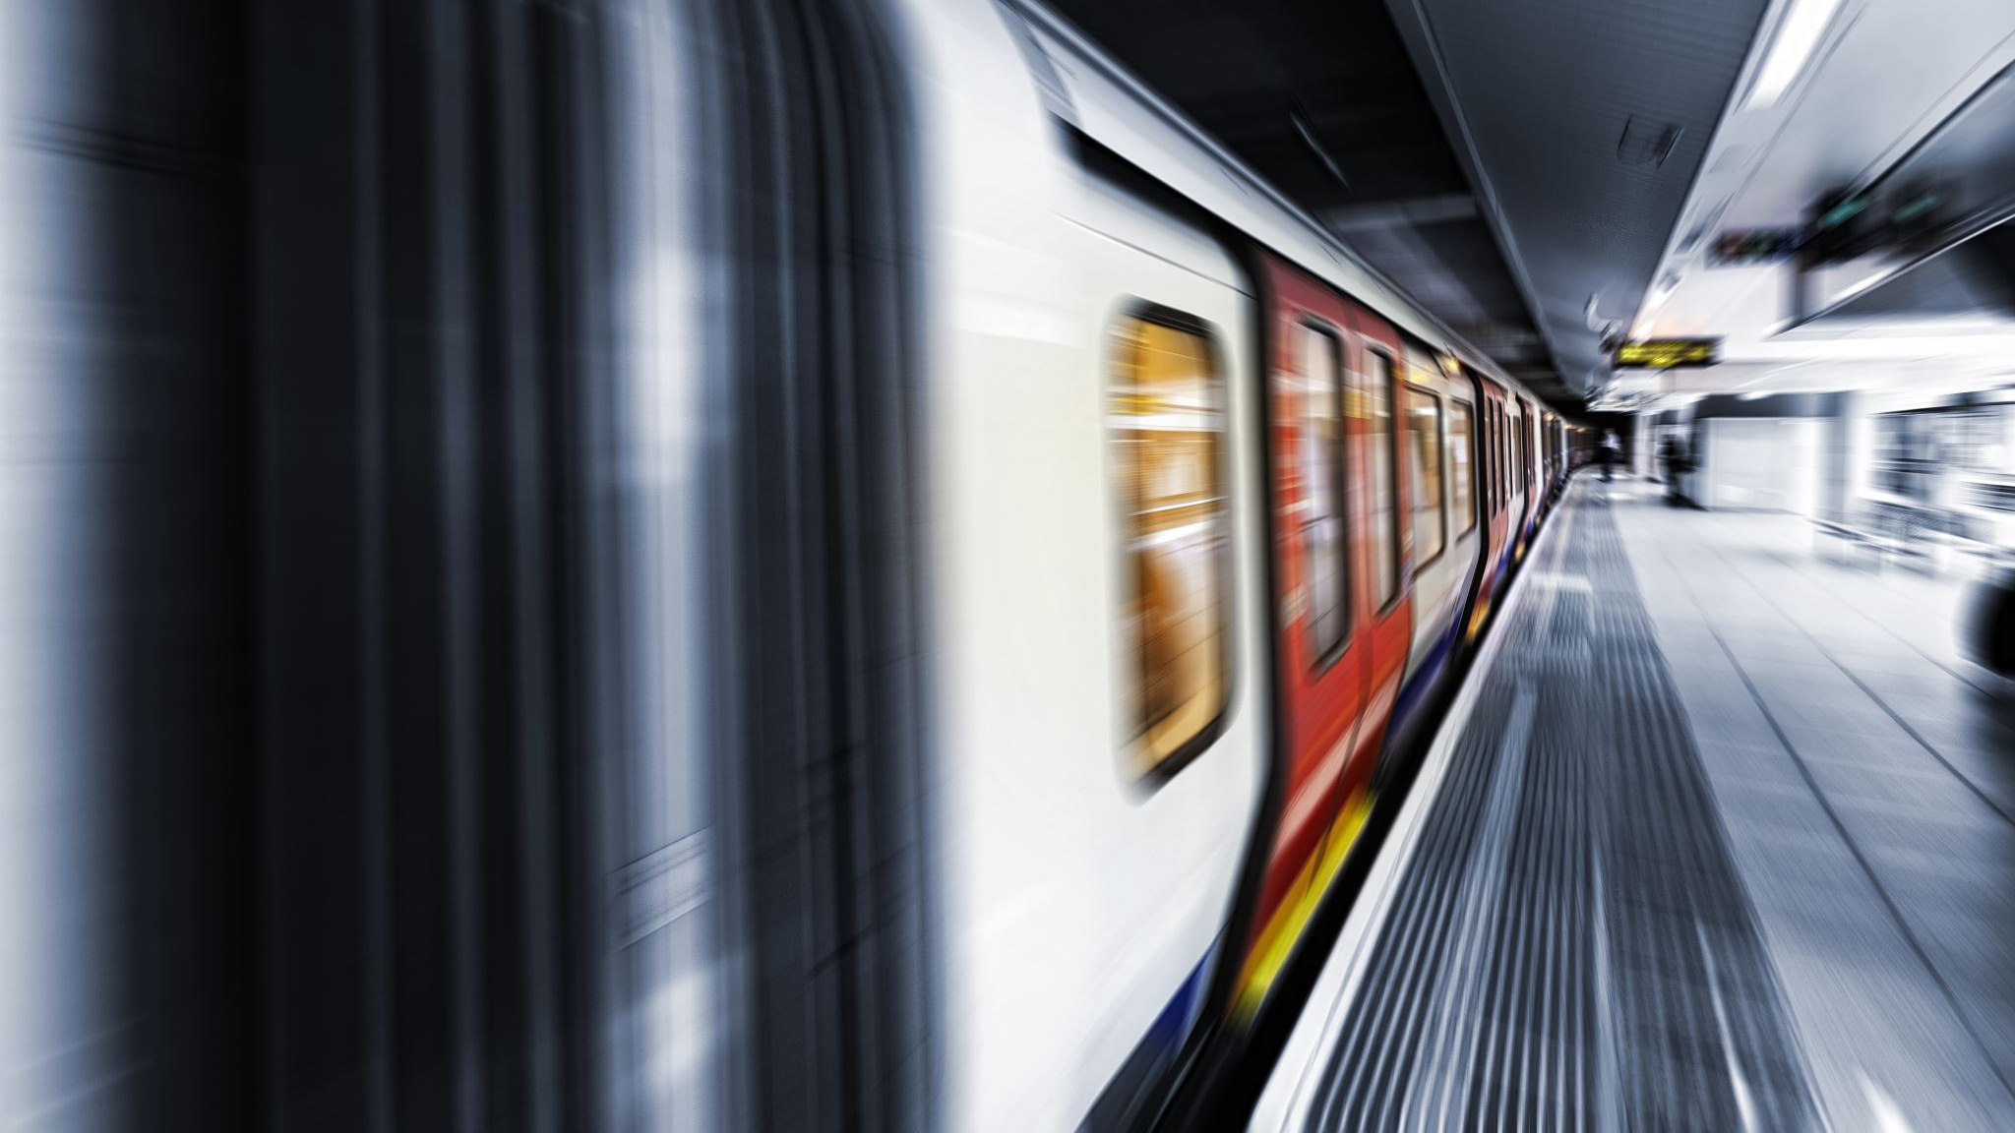
Which municipality saw the greatest change in train usage, and which station saw the greatest change in the City of Melbourne?
Presented by Tao Ma

Slide 12
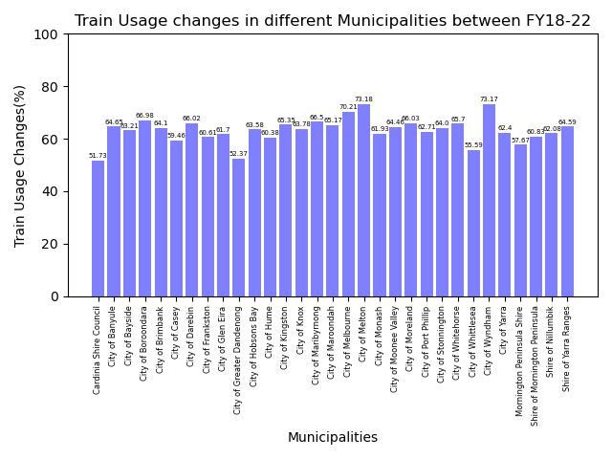

Slide 13
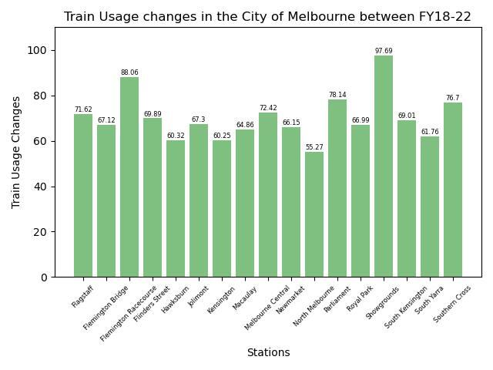

Slide 14
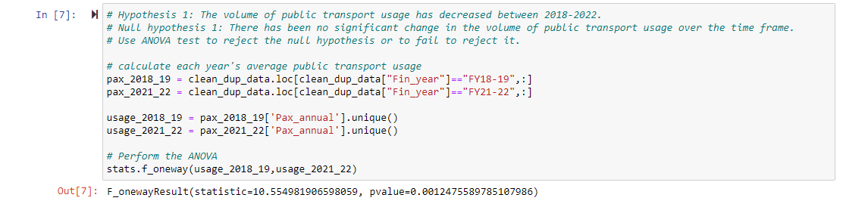
Hypothesis testing (anova)

Slide 15
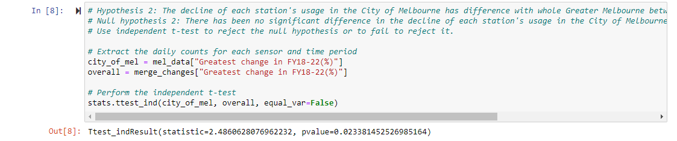
Hypothesis testing (t-test)

Slide 16
Conclusions
The usage of trains has significantly decreased by around 60% between June 2018 and June 2022. The City of Melton, City of Wyndham, and City of Melbourne have experienced the greatest decline.
In the City of Melbourne, the Showgrounds and Flemington Racecourse have experienced the greatest changes in train usage. It can be seen that the lockdown and the pandemic have the greatest impact on entertainment activities, such as horse racing and shows.
Since the p-values for both hypotheses are less than 0.05, we can reject the Null hypothesis and conclude that there has been a significant decrease in train usage during the period. Additionally, the City of Melbourne has seen a greater decrease in train usage compared to Greater Melbourne.

Slide 17
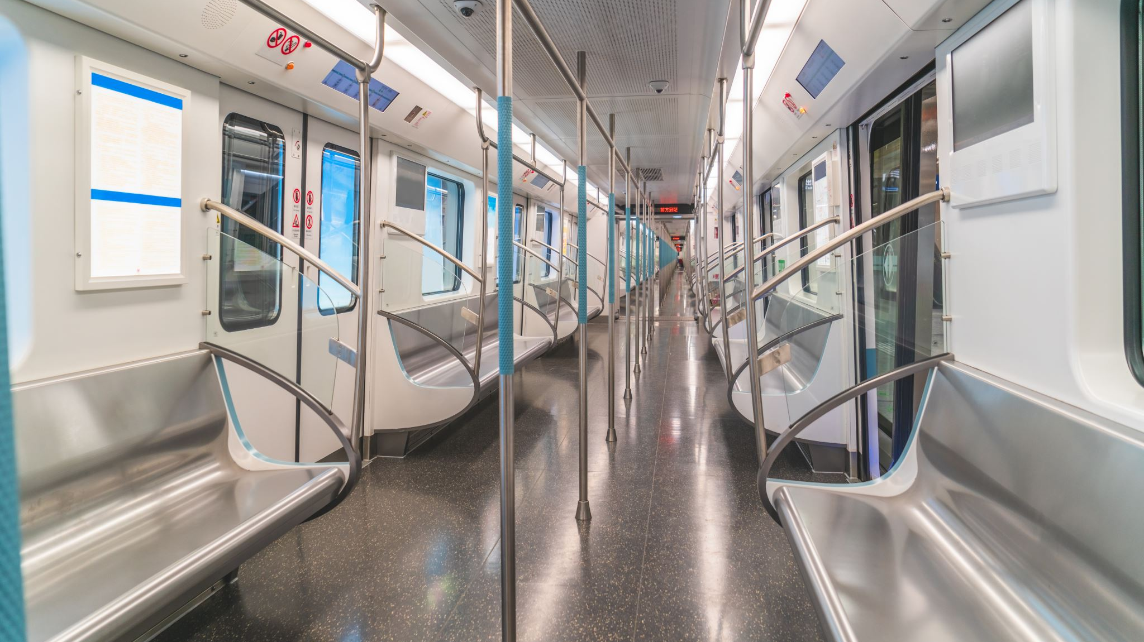
Did the pandemic affect the peak hours of train usage in Metropolitan Melbourne?
Presented by Jai Gupta

Slide 18
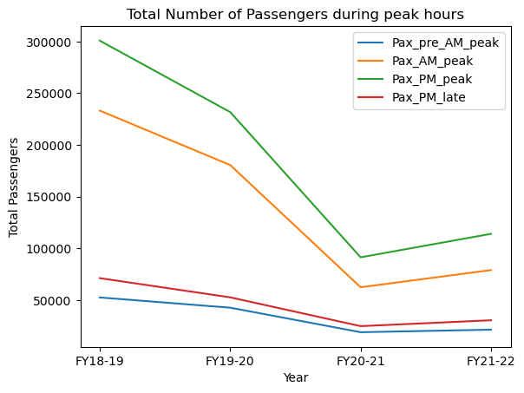

Slide 19
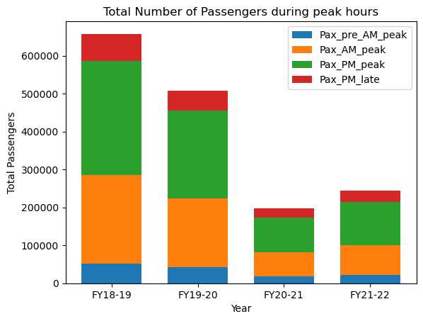

Slide 20
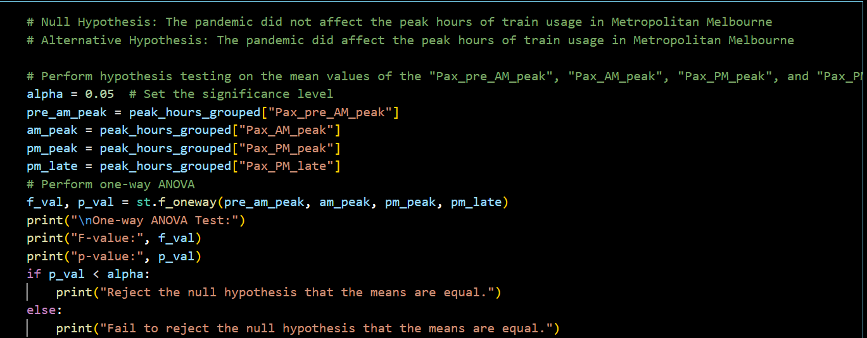
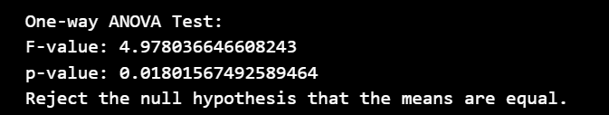
Hypothesis testing (anova)

Slide 21
conclusions
The conclusion drawn from the hypothesis testing is that we can reject the Null hypothesis that did not affect the peak hours of train usage in Metropolitan Melbourne. This means the Alternative hypothesis is supported, indicating that the pandemic did affect the peak hours of train usage in Metropolitan Melbourne.
Considering Line chart and Bar graph , we can observe the total number of passengers during peak hours of each Financial year, we can observe a significant decrease in the total number of passengers during peak hours in the financial year 2020-2021 compared to the previous financial years. This decrease can be attributed to the pandemic, which caused changes in people's travel behavior due to lockdowns, remote work policies and other factors related to the pandemic.

Slide 22

How has the volume of pedestrian traffic in Melbourne’s CBD evolved over the time frame?
Presented by Owen Johannes

Slide 23
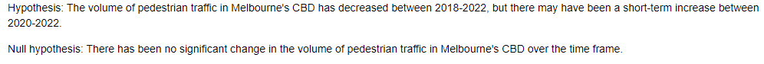
Hypothesis

Slide 24
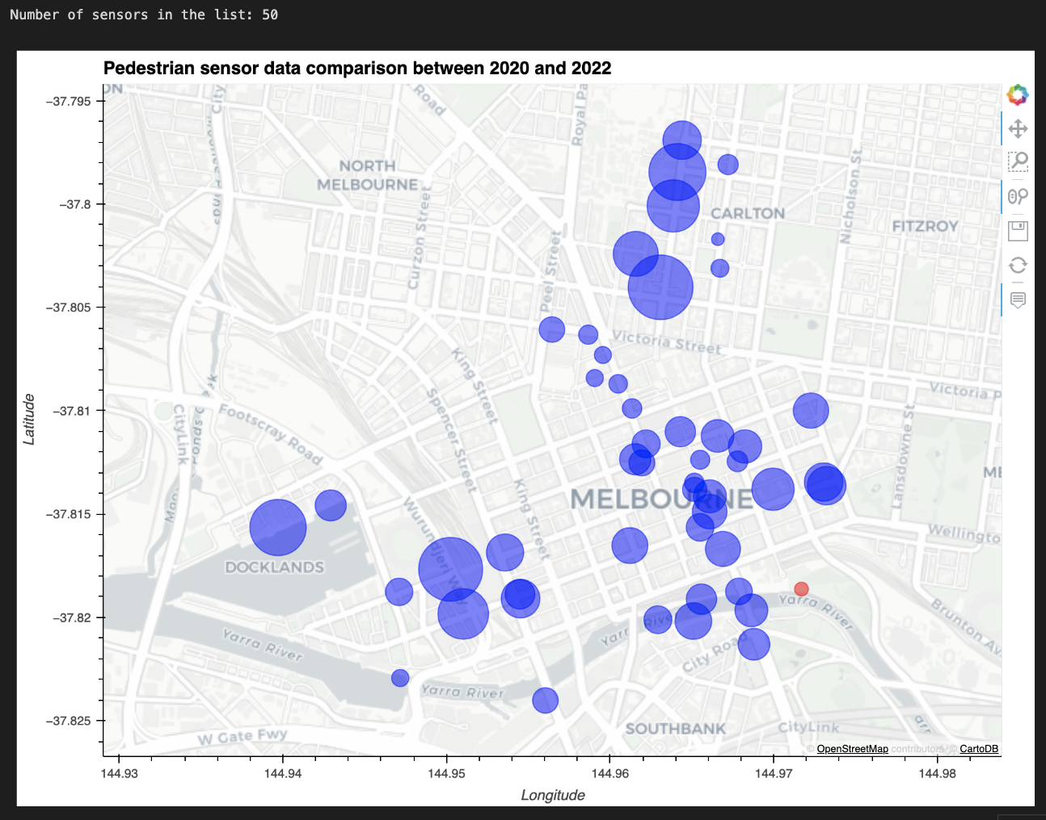

Slide 25
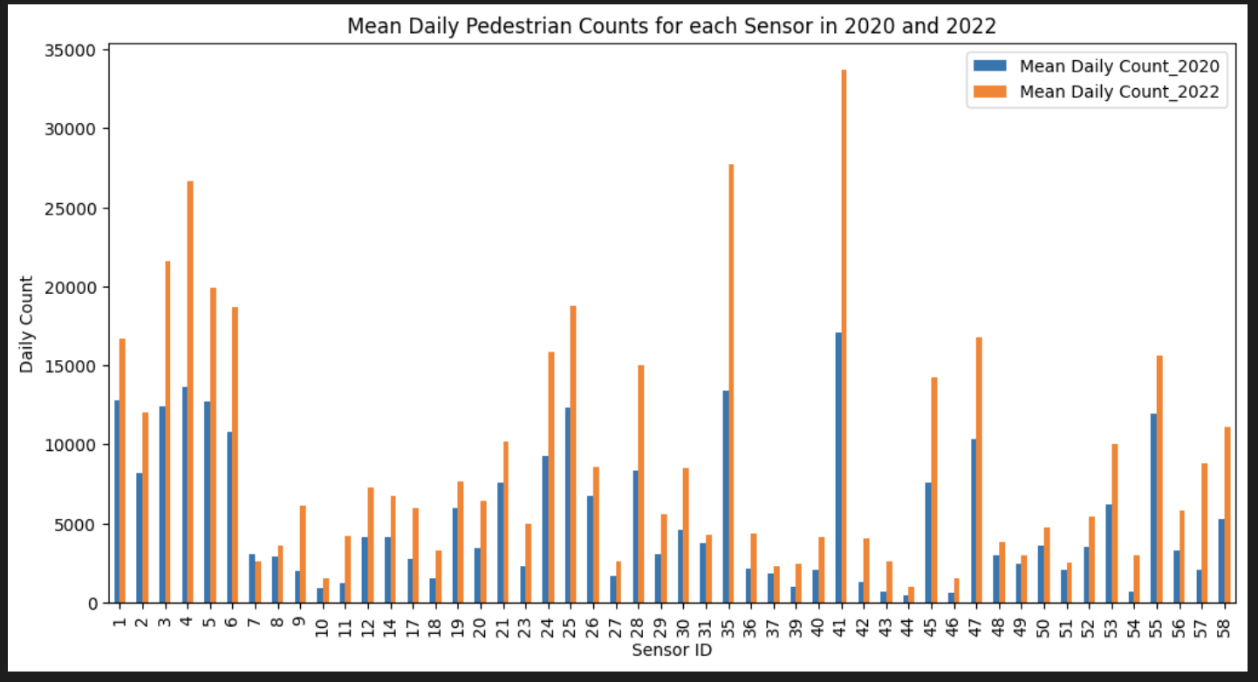

Slide 26
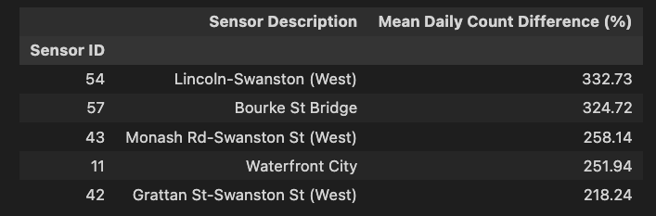
Top 5 sensors

Slide 27
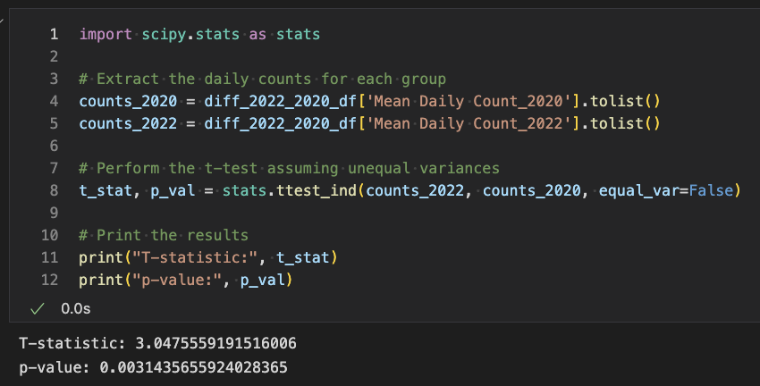
Independent t-test

Slide 28
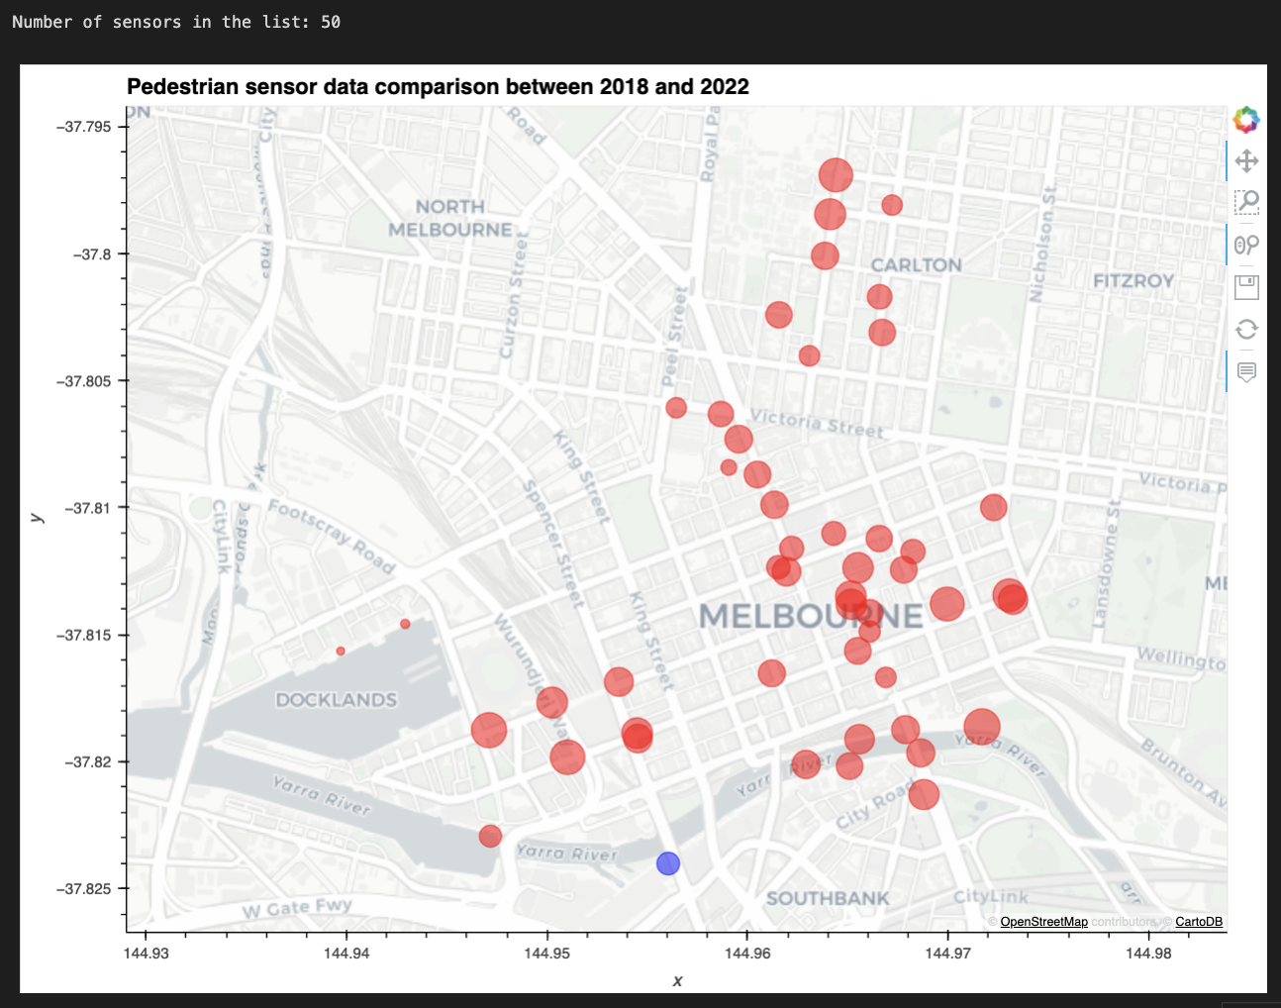

Slide 29
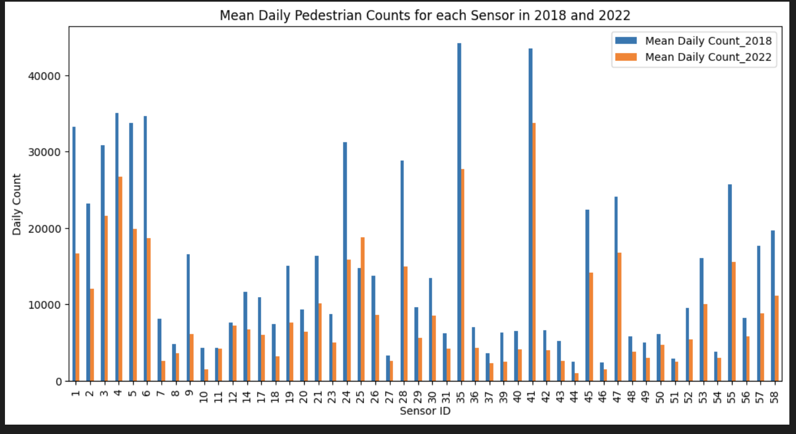

Slide 30
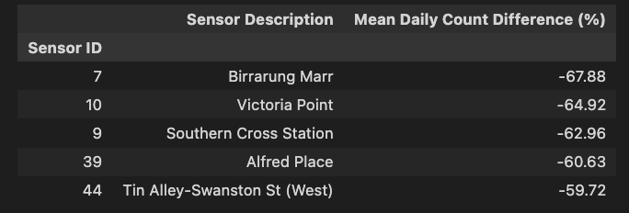
Bottom 5 sensors

Slide 31
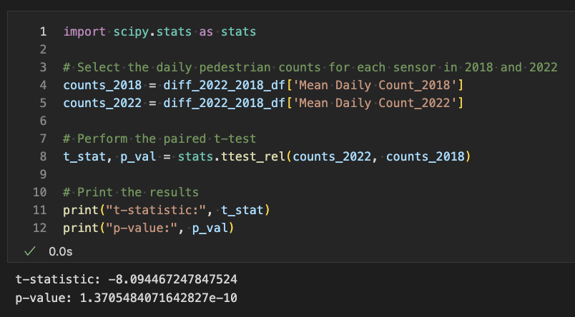
related t-test

Slide 32
conclusions
Based on the two statistical analyses performed, there is evidence to suggest that the volume of pedestrian traffic in Melbourne's CBD has decreased between 2018-2022. The paired t-test on the daily pedestrian counts for each sensor in 2018 and 2022 found a statistically significant decrease in pedestrian traffic over that time frame. Additionally, the t-test with unequal variances on the daily pedestrian traffic counts between 2020-2022 found evidence for a short-term increase in pedestrian traffic, although the overall trend for the entire time frame is unclear.
In summary, there has been a significant decrease in pedestrian traffic in Melbourne's CBD over the past few years, with some indications of a short-term increase more recently.

Slide 33
overall conclusions
Presented by Tattwamasi Ray

Slide 34
Limitations of the datasets
Some of the datasets were altered a lot over the time period. For example, some of the sensor locations were not available over the whole 2018-2022 time period.
The potential usage not tracked with fare evasion, or even with tram users accidentally not tapping on or off due to the free tram zone in Melbourne.
Covid cases not being tracked due to people avoiding testing facilities or not reporting positive testing.
There are other reasons outside of COVID and lockdowns that could cause people to not use public transport or shift from a train to a bus such as all the works being done on level crossings. Availability of these services is not always reliable.

Slide 35
What did we discover?
The trend for all three metropolitan public transport services was relatively stable from June 2018 to March 2020(Pre-COVID lockdowns). From April 2020 to November 2020, all three metropolitan transport services experienced a significant decline in customers due to COVID-19 restrictions. From June 2021 to November 2021 Metropolitan tram services were affected the most due to significant decline in passengers due to COVID-19 restrictions. From November 2021 to June 2022, all three Metropolitan transport services showed signs of recovery with the number of passengers increasing steadily.
The usage of trains in particular has significantly decreased by around 60% between June 2018 and June 2022. The City of Melton, City of Wyndham, and City of Melbourne have experienced the greatest decline.
There is an inverse correlation between the number of new COVID cases and the numbers of customers using metropolitan public transport services during COVID lockdowns.
Considering the data regarding the total number of passengers during peak hours of train usage, there is strong evidence that the pandemic had a significant impact on those time slots.
People are slowly returning to their pre-pandemic mobility patterns and are starting to use public transport again but have remained hesitant.
Policymakers should make efforts to improve public transport services, especially in the post-COVID era, to encourage more people to return to using public transport as their preferred mode of transportation.

Slide 36
Thank you!

